Slide 1
Unsupervised Learning – Clustering
Aniket Chhabra

Slide 2
Education & Employment History
Assistant Manager (Finance & Pricing Analytics)
Genpact India, Gurugram
Jul 2011 - Nov 2015
Lead (Business Analytics & Research)
Fidelity Investments, Bengaluru
Nov 2015 - Jan 2019
PGPBA
Great Lakes Institute of Management, Gurgaon/Bangalore
July 2015 - July 2016
Lead Data Scientist (Advanced Analytics & Decision Strategy)
PayPal India, Chennai
Jan 2019 - Present
Mentor
(Data Science and Business Analytics (DSBA))
GreatLearning, India
Sep’2020 - Present

Slide 3
Agenda/Objective of the session
Unsupervised Learning – Intuition behind K-means Clustering (15 mins)
College Applications data profiling using k-means clustering – A case study approach (20 mins)
Questions and Answers session (10 mins)

Slide 4
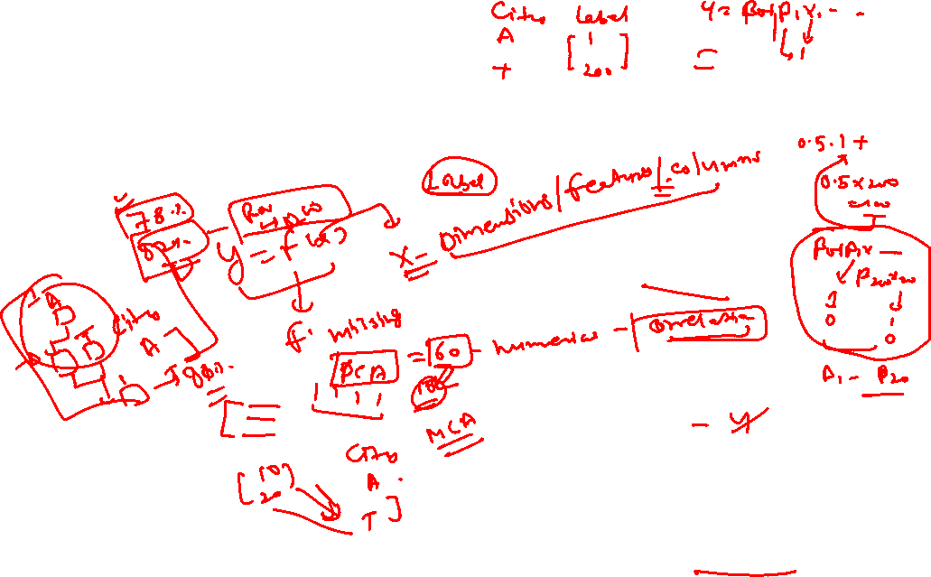
What is Unsupervised learning?
We look at methods to discover unknown relationships in data. These methods are called unsupervised methods. With unsupervised methods, there’s no outcome that you’re trying to predict; instead, you want to discover patterns in the data that perhaps you hadn’t previously suspected.
You are probably trying to unearth some hidden treasures !!
No defined dependent variable
Pattern in the data to identify similarity
Supervised Learning -
Unsupervised Learning -
Clearly defined X and Y variables
Predict a continuous response (Regression)
Categorical response (classification)
It works for primarily on the Label Data
Un-labeled data
Emerging patterns based on similarity identified
Clustering and PCA
Association rules (market basket analysis)

Slide 5
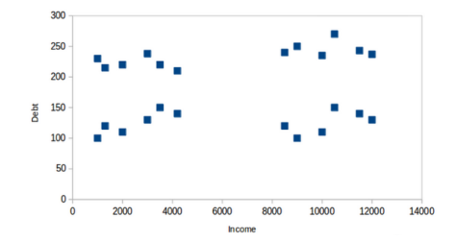
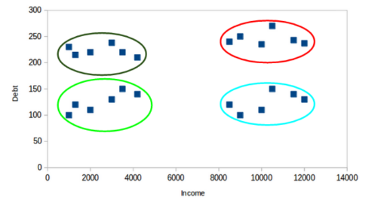
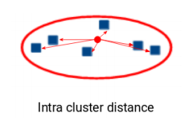
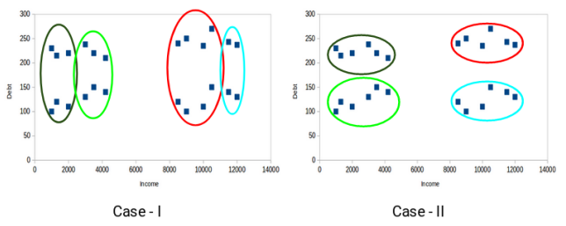
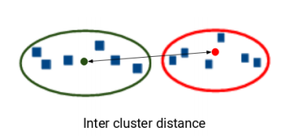
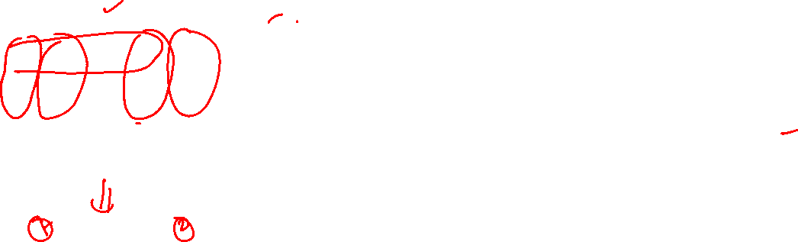
What is Clustering?
No defined dependent variable
Pattern in the data to identify similarity
Grouping datapoints - rows
Homogeneity within datapoints
1
2
Heterogeneity between datapoints
3
SSB > SSW
4

Slide 6
Types of clustering
Clustering
Hierarchical
Agglomerative
Divisive
Partitioning
K-Means/Medoids
/Mode
Bottom-up approach
start with each object forming a separate group
It keeps on merging the objects or groups that are close to one another
Top-down approach
start with all the objects in the same cluster
a cluster is split up into smaller clusters
Iterative process
constructs ‘k’ partition of data
Each partition will represent a cluster and k ≤ n
Minimize the distance of a data point from the center of each of the cluster

Slide 7
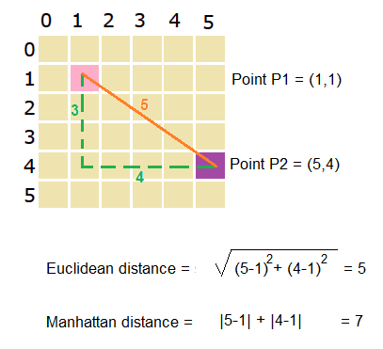
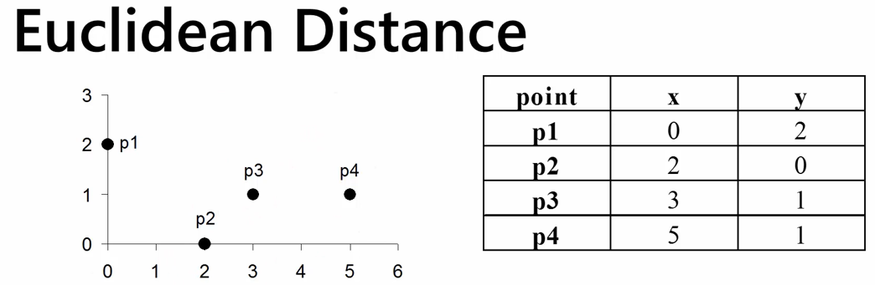
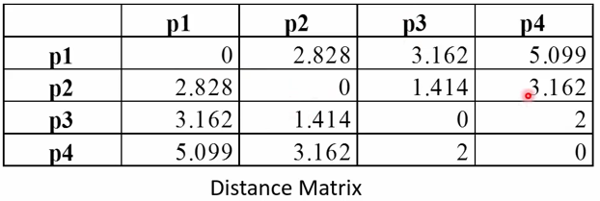

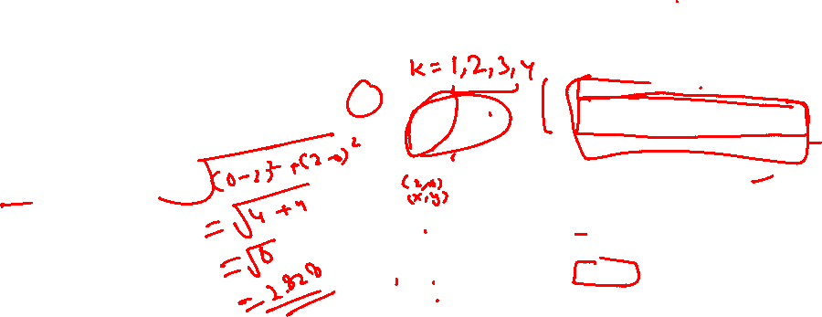
Technical Anatomy of Clustering – Distance Algorithms
Different measures are used to calculate the distance. In this section, we’ll cover a few of the most common ones.
Numerical Data
Euclidean Distance
1
The most common distance is Euclidean distance. The Euclidean distance between two vectors x and y is defined as -
Manhattan Distance
2
Manhattan distance measures distance in the number of horizontal and vertical units it takes to get from one (real-valued) point to the other (no diagonal moves)

Slide 8
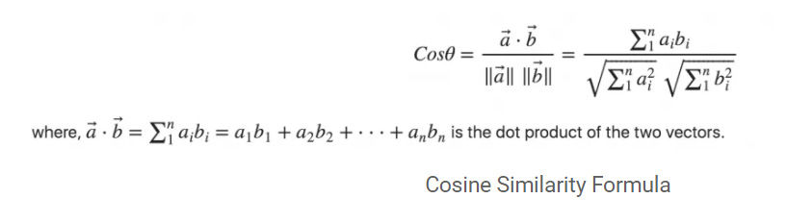
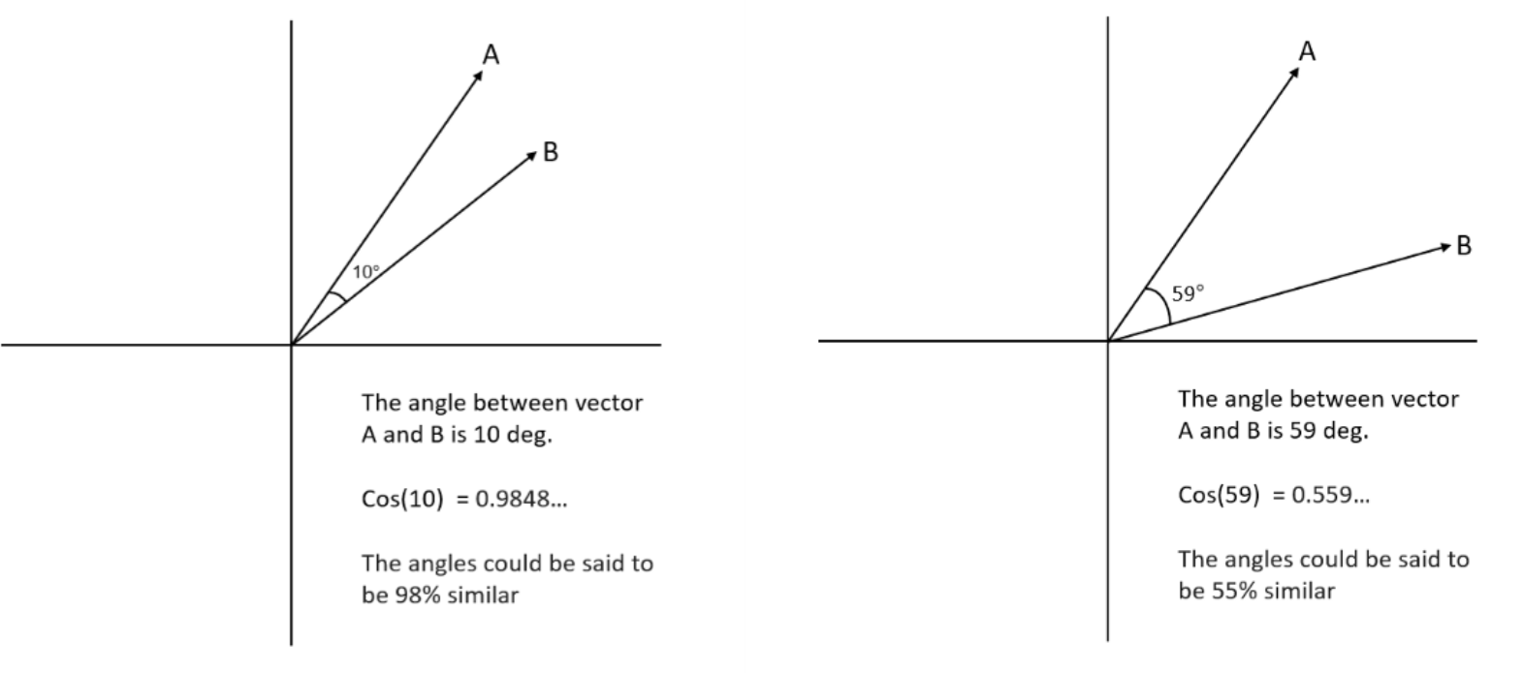
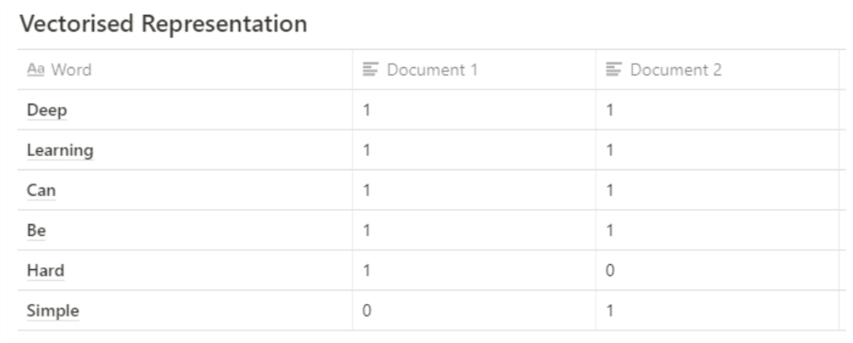
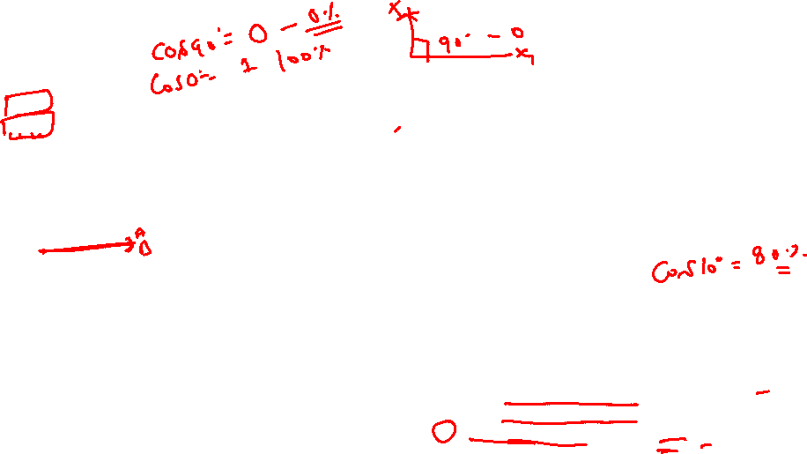
Technical Anatomy of Clustering – Distance Algorithms
Different measures are used to calculate the distance. In this section, we’ll cover a few of the most common ones.
Categorical Data
Cosine Similarity
1
Cosine similarity is a common similarity metric in text analysis. It measures the smallest angle between two vectors (the angle theta between two vectors is assumed to be between 0 and 90 degrees).
Two perpendicular vectors (theta = 90 degrees) are the most dissimilar; the cosine of 90 degrees is 0.
Two parallel vectors are the most similar (identical, if you assume, they’re both based at the origin); the cosine of 0 degrees is 1.
From elementary geometry, you can derive that the cosine of the angle between two vectors is given by the normalized dot product between the two vectors:
Here’s an example:
Document 1: Deep Learning can be hard
Document 2: Deep Learning can be simple
Document 1: [1, 1, 1, 1, 1, 0] let’s refer to this as A
Document 2: [1, 1, 1, 1, 0, 1] let’s refer to this as B
Above we have two vectors (A and B) that are in a 6-dimension vector space
Step 1: First we obtain a vectorized representation of the texts
Step 2: Find the cosine similarity
Calculate the dot product between A and B: 1.1 + 1.1 + 1.1 + 1.1 + 1.0 + 0.1 = 4
Calculate the magnitude of the vector A: √1² + 1² + 1² + 1² + 1² + 0² = 2.2360679775
Calculate the magnitude of the vector B: √1² + 1² + 1² + 1² + 0²+ 1² = 2.2360679775
Calculate the cosine similarity: (4) / (2.2360679775*2.2360679775) = 0.80 (80% similarity between the sentences in both document)

Slide 9
Technical Anatomy of Clustering – Distance Algorithms
Different measures are used to calculate the distance. In this section, we’ll cover a few of the most common ones.
Mixed Data
Gower Distance
1
Gower’s Distance can be used to measure how different two records are. The records may contain combination of logical, categorical, numerical or text data. The distance is always a number between 0 (identical) and 1 (maximally dissimilar). Data types –
quantitative (interval): range-normalized Manhattan distance
ordinal: variable is first ranked, then Manhattan distance is used with a special adjustment for ties
nominal: variables of k categories are first converted into k binary columns and then the Dice coefficient is used
*Refer to python & R notebooks to access the codes and examples
Apart from this there are quite a few distance measures like Maholanobis distance etc. which is often used in many such exercises

Slide 10
How does k-means clustering work?
1
Select the number of clusters for the dataset (K)
2
Select K number of centroids
3
Assign each of the data points (rows) based on the
distance of each of the data point from centroids
4
Find the new centroids for each of the K clusters/group
(mostly mean)
5
iteratively repeat step 1-4 until all the points are
assigned to their respective clusters.

Slide 11
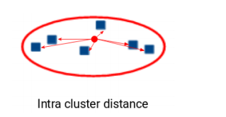
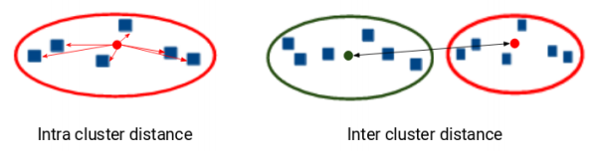
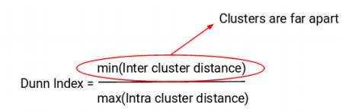
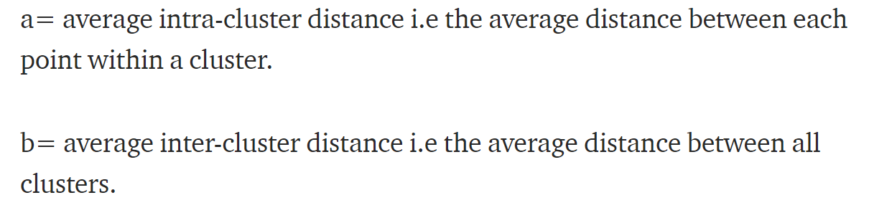

Evaluation of Clusters
Inertia
Inertia calculates the sum of distances of all the points within a cluster from the centroid of that cluster.
1
We can say that the lesser the inertia value, the better our clusters are.
Dunn Index
If the distance between the centroid of a cluster and the points in that cluster is small, it means that the points are closer to each other. So, inertia makes sure that the first property of clusters is satisfied. But it does not care about the second property – that different clusters should be as different from each other as possible.
2
Dunn index is the ratio of the minimum of inter-cluster distances and maximum of intra cluster distances.
Silhouette Score
Goodness of fit for number of clusters
3
The value of the Silhouette score varies from -1 to 1. If the score is 1, the cluster is dense and well-separated than other clusters. A value near 0 represents overlapping clusters with samples very close to the decision boundary of the neighboring clusters. A negative score [-1, 0] indicates that the samples might have got assigned to the wrong clusters

Slide 12
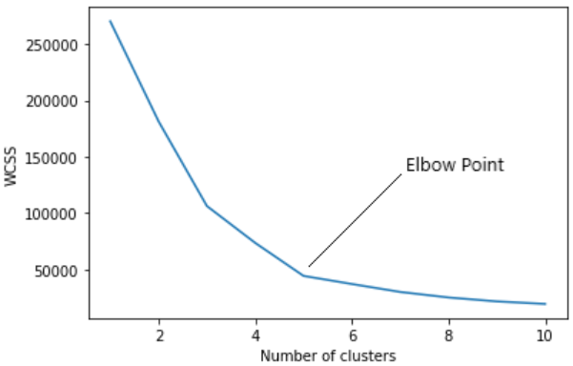
Finding the number of Clusters – K means?
Elbow Method
For each value of K (number of clusters) calculate within cluster sum of squares (WSS) or inertia. Ideally the WSS value should monotonically decreasing meaning as number of clusters increases the WSS should decrease.
WSS is the sum of squared distance between each point and the centroid in a cluster. We plot the WSS with the K value, the plot looks like an Elbow:-
Wherever the graph takes an elbow shape or kink appears, we select the number of clusters accordingly. In the above graph K=5 is the optimal number of clusters should be chosen.
Note – There are other ways to select the number of clusters like – wherever the Silhoutte score is highest, or using hierarchical clustering before k-means to come up with number of clusters

Slide 13
Process Flow for Cluster Analysis – K-means
Collect and Prepare the data for analysis
Creating New Relevant Variables
Create Training and Validation datasets
Step 1
Step 2
Step 3
Multicollinearity Check
Treatment of Missing Values
Tackling the Outliers
Step 6
Step 5
Step 4
Getting Cluster Solution/Validation
Profile the clusters generated
Standardization
Step 7
Step 8
Step 9

Slide 14
Clustering Algorithm in Action
Application of k-means is very common across industries – Retail, Finance, Banking, Fintech and Product Portfolio etc
Document Classification
Web
Customer Segmentation
Market structure analysis
Finance
Cluster documents in multiple categories based on tags, topics, and the content of the document
Cluster groups of users based on their access patterns on webpages
Cluster webpages based on their content
customers are segmented based on demographic and transaction history information, and a marketing strategy is tailored for each segment
identifying groups of similar products according to competitive measures of similarity
Cluster analysis can be used for creating balanced portfolios
Notes:
https://dzone.com/articles/10-interesting-use-cases-for-the-k-means-algorithm
https://datafloq.com/read/7-innovative-uses-of-clustering-algorithms/6224

Slide 15
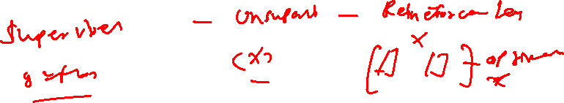
Challenges with k-means clustering
There are two main challenges that need to handled wisely in order to get the most out of the k-means clustering algorithm:
Defining the number of clusters
Determining the initial centroids

Slide 16
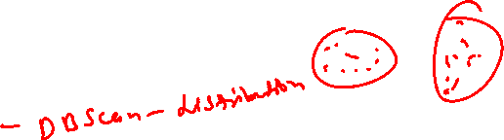
Other Types of Clustering – enter the Bigger Universe
Apart from what we discussed as methods for Clustering there are lot of other types of clustering algorithms: To name a few -----
Clara Algorithm
PAM Algorithm
Kernel Weighted K-Means
Fuzzy K-Means
Fuzzy K- Medoids
K-Modes Clustering
Clustering of Binary Variables
Bagged Clustering
Affinity Propagation Clustering
Density-Based Cluster Analysis
Rousseeuw-Kaufman’s Fuzzy Clustering Method

Slide 17
Move to Python Notebooks

Slide 18
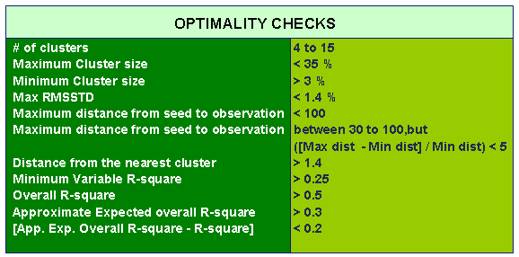
Cluster Solution

